Slide 1


Faculty of Graduate Studies for Statistical Research
Software Engineering Professional Master Program
Study of the effect of alcoholic beverages on the driving patterns of adult drivers
دراسة تأثير المشروبات الكحولية على أنماط القيادة للسائقين البالغين
MASTER RESEARCH PROPOSAL
Submitted by:
Mohamed Salah Ibrahim Salem
Under supervision of:
Prof. Mervat Gheith. Dr. Tarek Aly

Slide 2
Outline
Background
Problem Definition
Research Importance
Pervious Work
Research Objective
Research Plan
Implementation Methods
Solution Architecture Diagrams
Research Contribution
Evaluation

Slide 3
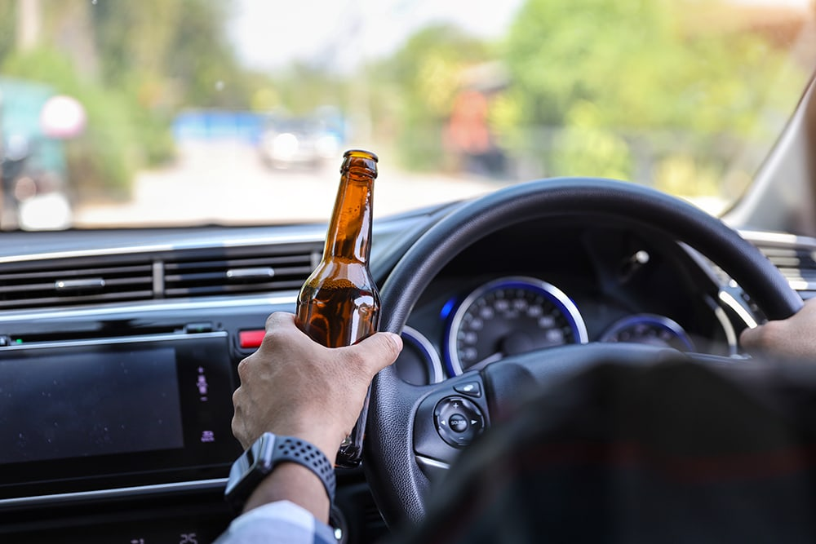
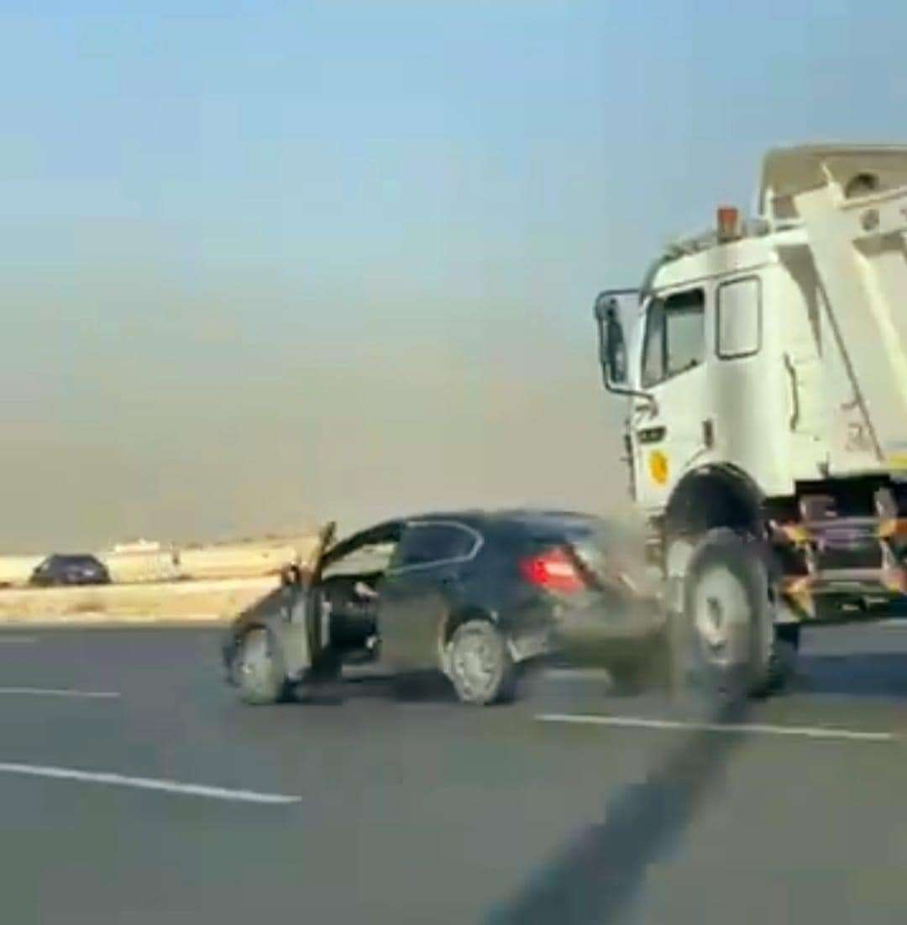
Current State
Background
The dangerous Driving under the influence of alcohol.
Causing traffic accidents and endangering the lives of drivers and pedestrians
Difficulty in automatically detecting drivers who consumed alcohol before the accident .

Slide 4
Problem Definition
Driving under the influence of alcohol remains a significant contributor to road accidents and poses a severe threat to road safety worldwide. Unfortunately, no integrated solution in Egypt between cars and traffic police to detect abnormal driving patterns to prevent accidents before they happen.

Slide 5
Research Importance
Predicting traffic accidents before they happen.
Facilitating the process of arresting violating drivers easily and quickly.
Create different driving styles and measurement tools to help test drivers' proficiency.
Use the solution for commercial and public safety purposes.

Slide 6
Previous Work
Year | Paper | Contribution
2023 | Driver Profile and Driving Pattern Recognition for Road Safety Assessment: Main Challenges and Future Directions | reviewed artificial intelligence and machine learning Methods used so far in driver profile and driving style Recognition studies for traffic safety analysis purposes . driving style . driving pattern .
2022 | A Review for the Driving Behavior Recognition Methods Based on Vehicle Multisensor Information | This paper reviews and summarizes driving behavior recognition methods based on vehicle sensor information fusion. On-board sensor data contain a wealth of information about driving behavior . Use many ai models to detect driver behavior

Slide 7
Research Objective
Develop a full solution (DPObserver System) based on an AI model (Machine learning) to detect driving patterns, ready for use/integration with any system.

Slide 8
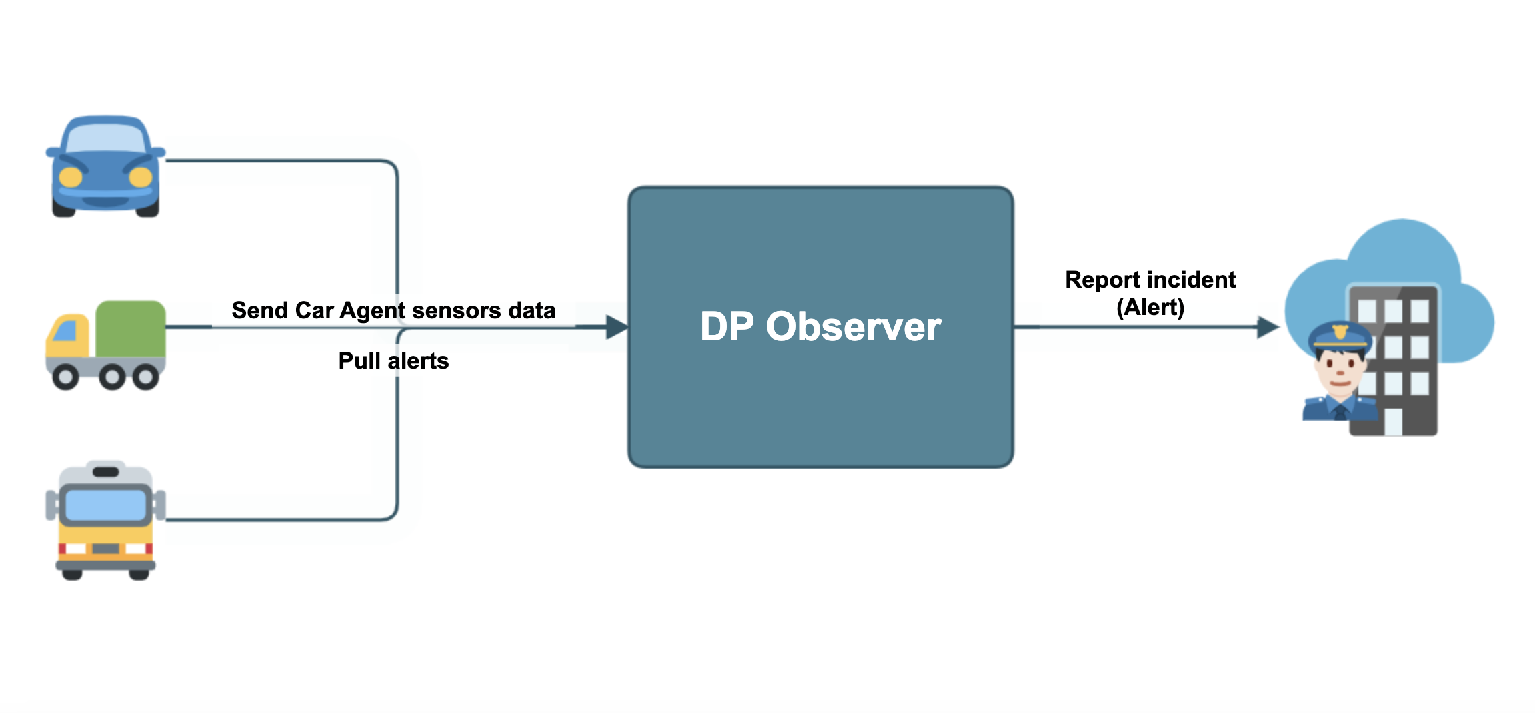
Solution Architecture
1- Context Diagram
Police system
Process all data and make decision
Data source

Slide 9
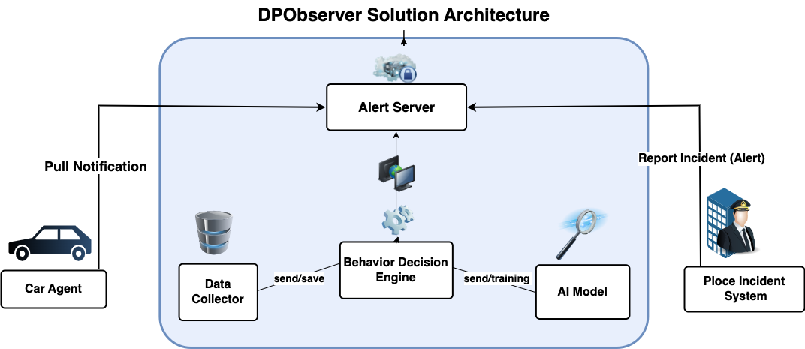
Solution Architecture
2- Components Diagram

Slide 10
Solution Architecture Diagrams
3- Technology Diagram
Front-end layer (Angular V 15.1)
DATA BASE
layer
(No SQL - MogoDB)
AI Model Env layer (flask V 2.3.3)
Back-end layer (NodeJS V 18.17.1)

Slide 11
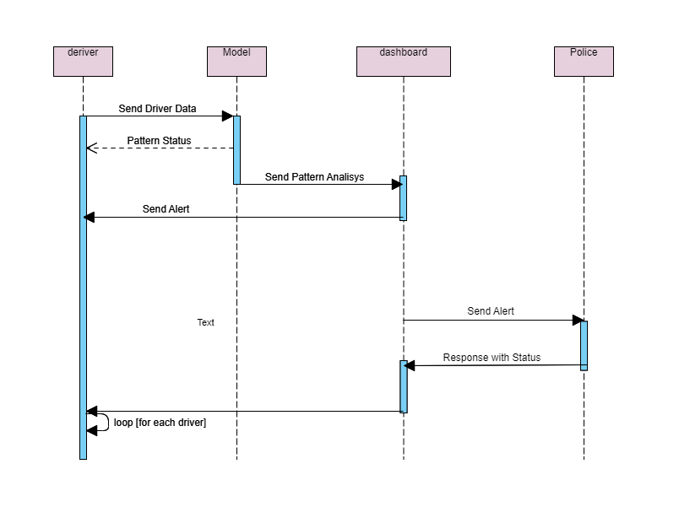
Solution Architecture Diagrams
4- Sequence Diagram

Slide 12
Research Contribution
build and Evaluate the potential impact of the developed solution on reducing alcohol-related accidents and enhancing overall road safety.

Slide 13
Evaluation
1- different algorithms I used on my data.
No. | Algorithm | Data length | Accuracy
1 | KNN Model | 55 | 0.76%
2 | Cluster Model | 55 | 0.72%
3 | Neural Network Relu Activation | 55 | 0.79%

Slide 14
Evaluation
2- Evaluate results after test DPObserver solution.
Users | Results | length | Precentage
43 | Right Detection/Recognize | 28 | 0.66%
2 | Wrong Detection/Recognize | 15 | 0.34%

Slide 15


Thank You

